Slide 1
Transfer Learning Introduction and Fine-tuning
Dr. Yan Yan

Slide 2
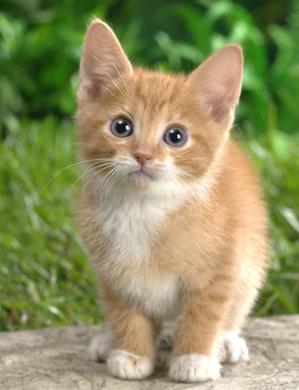
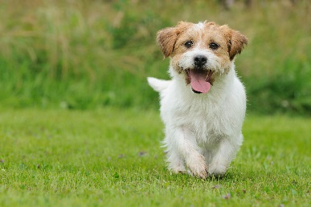

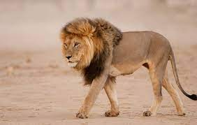
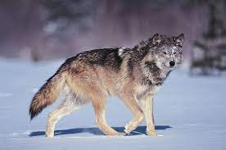
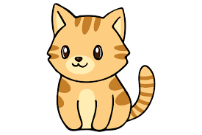
Transfer Learning
http://weebly110810.weebly.com/396403913129399.html
http://www.sucaitianxia.com/png/cartoon/200811/4261.html
Dog/Cat
Classifier
cat
dog
Data not directly related to the task considered
Lion
Wolf
cat
dog
Similar domain, different tasks
Different domains, same task

Slide 3


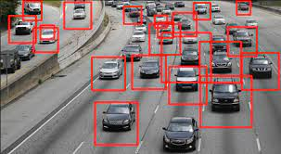


Why?
Task Considered
Data not directly related
Speech
Recognition
English
English
Chinese
……
Image Recognition
car
Text
Analysis
Specific domain
Webpages

Slide 4
Transfer Learning - Overview
Source Data (not directly related to the task)
labelled
unlabeled
Model Fine-tuning
labelled
Warning: different terminology in different literature
Target Data
unlabeled

Slide 5
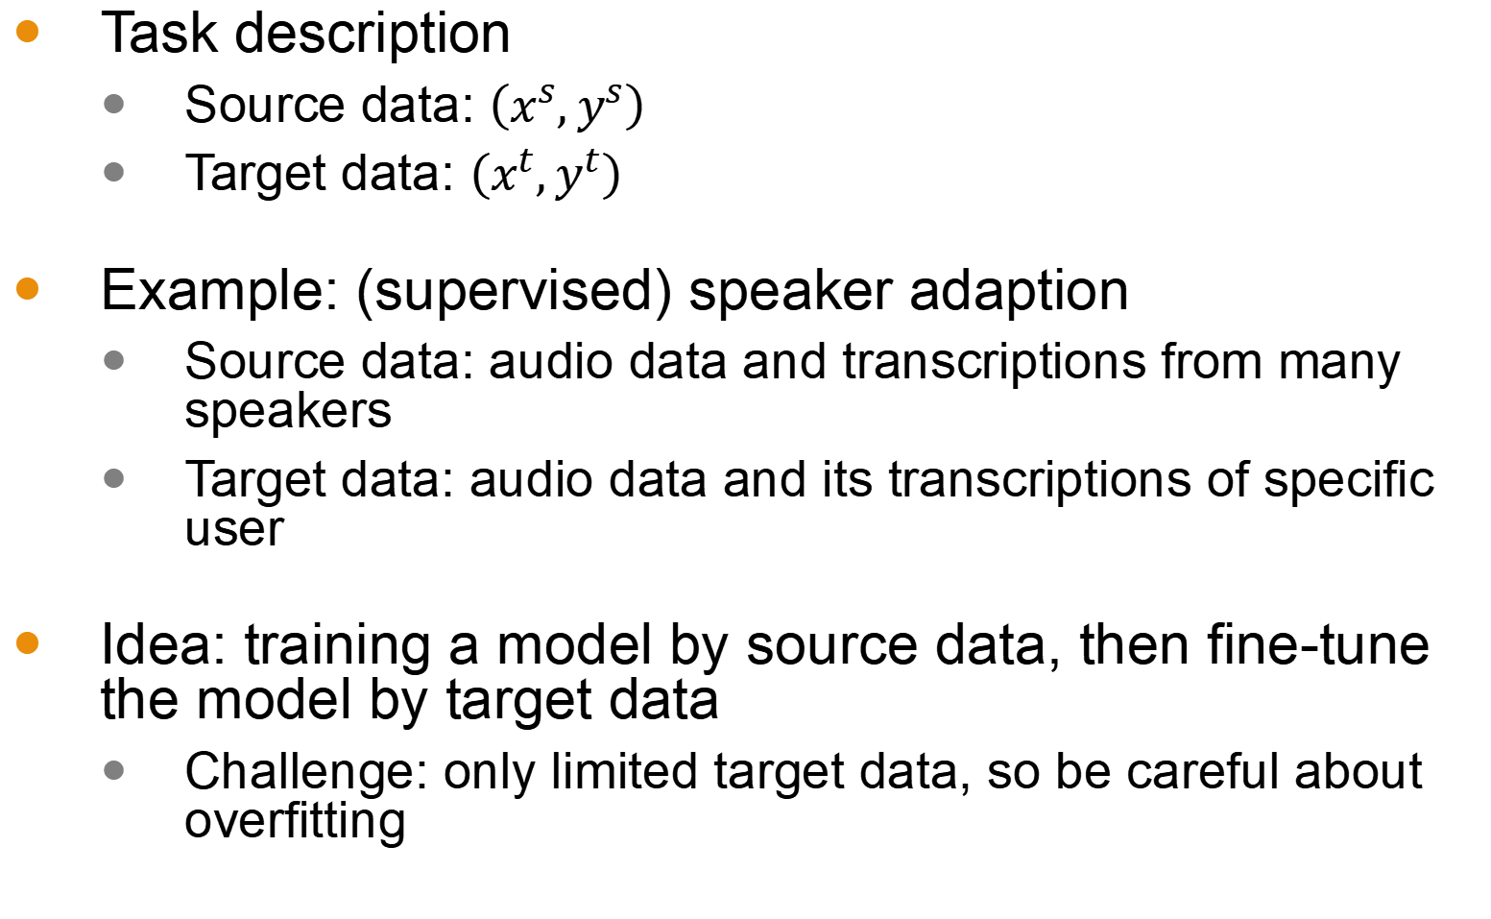
Model Fine-tuning
Model Fine-tuning
One-shot learning: only a few examples in target domain
Task description
Source data: $\left(x^{s},y^{s}\right)$
Target data: $\left(x^{t},y^{t}\right)$
Example: (supervised) speaker adaption
Source data: audio data and transcriptions from many speakers
Target data: audio data and its transcriptions of specific user
Idea: training a model by source data, then fine-tune the model by target data
Challenge: only limited target data, so be careful about overfitting
A large amount
Very little

Slide 6
Conservative Training
Output layer
output close
Output layer
parameter close
initialization
Input layer
Input layer
Source data
(e.g. Audio data of
Many speakers)
Target data (e.g. A little data from target speaker)

Slide 7
Layer Transfer
Output layer
Copy some parameters
Target data
Source data
Input layer
1. Only train the rest layers (prevent overfitting)
2. fine-tune the whole network (if there is sufficient data)

Slide 8






Layer Transfer
Which layer can be transferred (copied)?
Speech: usually copy the last few layers
Image: usually copy the first few layers
Pixels
Layer 1
Layer 2
Layer L
……
……
……
Lion
……
……
……
……
……
……

Slide 9
Layer Transfer - Image
fine-tune the whole network
Source: 500 classes from ImageNet
Only train the rest layers
Target: another 500 classes from ImageNet
Jason Yosinski, Jeff Clune, Yoshua Bengio, Hod Lipson, “How transferable are features in deep neural networks?”, NIPS, 2014

Slide 10
Layer Transfer - Image
Only train the rest layers
Jason Yosinski, Jeff Clune, Yoshua Bengio, Hod Lipson, “How transferable are features in deep neural networks?”, NIPS, 2014

